Slide 1

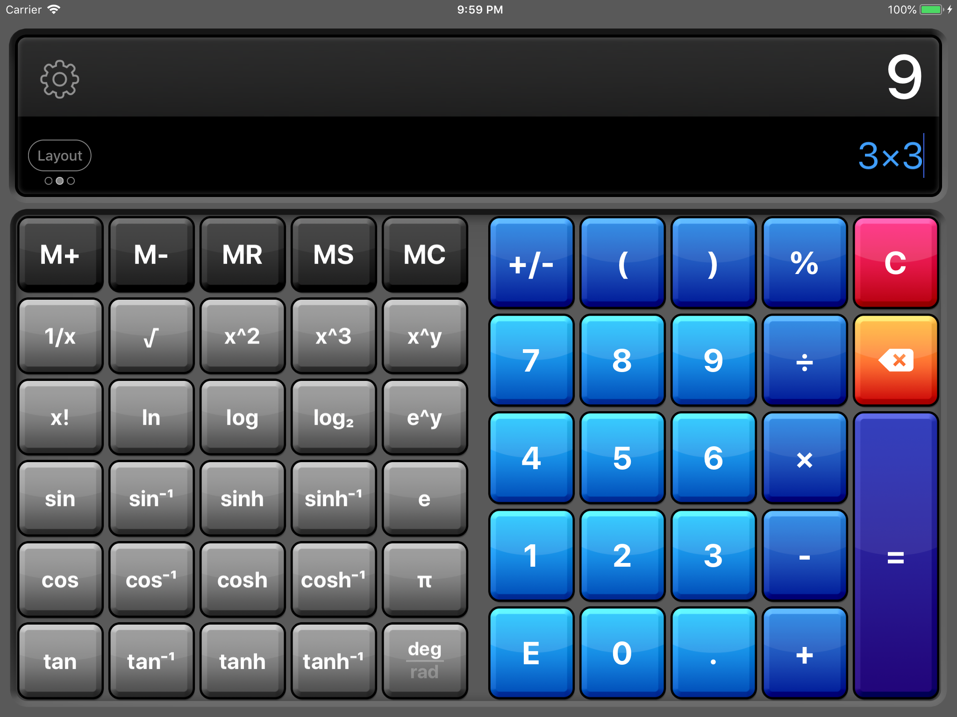
Company Name:- NEXTHIKE IT SOLUTONS
Batch No:-
Project Name:- SCIENTIFIC CALCULATOR
Made By:- Kuldeep Singh Yadav

Slide 2
ABOUT THE PROJECT:- A scientific calculator is a device that can perform complex mathematical calculations, statistical operations, and scientific functions. It can handle tasks beyond basic arithmetic, such as logarithms, exponentials, and trigonometry.
Scientific calculators are used by students, scientists, engineers, and professionals. They have more buttons than a standard calculator, which can only perform the four basic arithmetic operations. Scientific calculators are designed to help with problems in fields such as physics, chemistry, engineering, and trigonometry.

Slide 3

TOOLS FOR THE PROJECT :-
FROM PAYTHON :- In the Python, we can create a simple python calculator with the help of GUI tool a default library called tkinter that is based on user input, that can do fundamental arithmetic operations such as addition, subtraction, multiplication, and division. We can either create a simple calculator using the if-elif statements and an advanced calculator as well.

Slide 4
R & D:-
From first two weeks i had to go through all the aspects about the GUI based calculator using python with the help of internet, then i came to know there is a library in the python called tkinter thorough which we can create a calculator, after that i start reading tkinter and its applications, it took 3-4 days UDERSTAND THIS LIBRARY.
Then i insatll vs code in my laptop and start writing code in it, i had face many issues with the coding but resolve one by one at a time with the help of internet, at last i manage create a scientific calculator, this is the my journey with this project i enjoyed a lot, thanks to the NEXTHIKE IT SOLUTION for this lovely project.

Slide 5
T H A N K Y O U
DO YOU HAVE ANY QUESTIONS ?

